Slide 1
Simulation & Physics
2016-2017

Slide 2
Matrix: Geometric Interpretation
Matrix as transformation

Slide 3
Matrices and Geometry
A square matrix can perform any linear transformation. What’s that?
Preserves straight lines
Preserves parallel lines.
No translation: the axes do not move.

Slide 4
Properties of Matrix transformations
Matrix Transformations are Linear Transformations
Property 1: M⋅(x + y) = M⋅x + M⋅y
Property 2: M⋅(λx) = λM⋅x
Also:

Slide 5
Linear Transformations
Rotation
Scaling
Orthographic projection
Reflection
Shearing

Slide 6
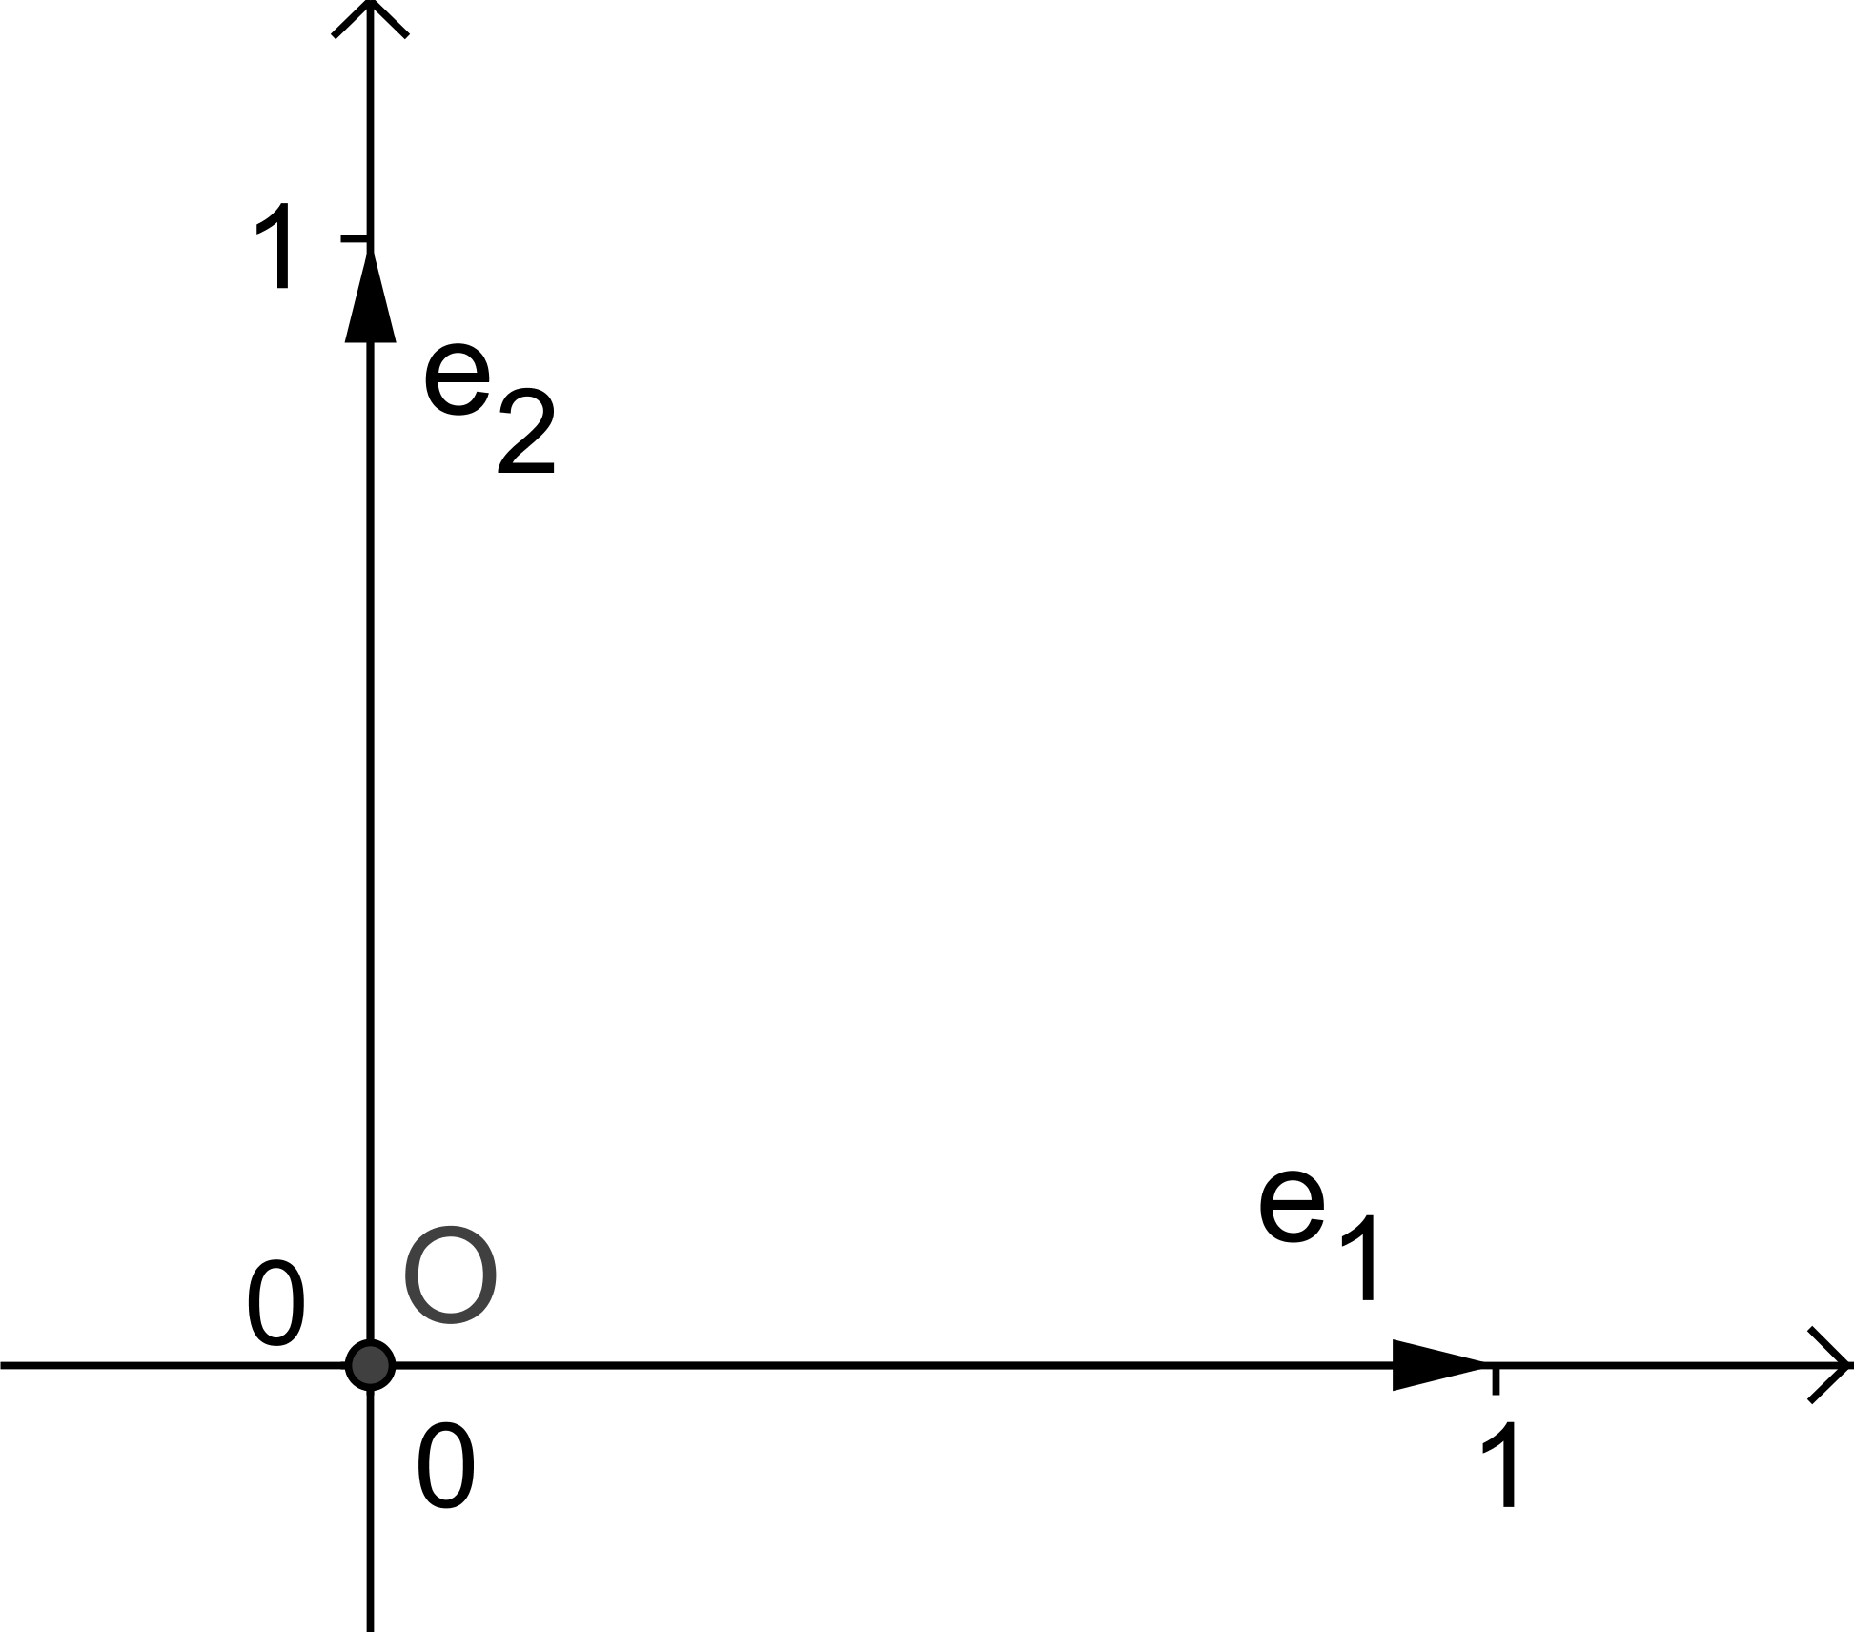
A Movie Quote
“Unfortunately, no-one can be told what The Matrix is – you have to see it for yourself.”
Actually, it’s all about basis vectors.

Slide 7
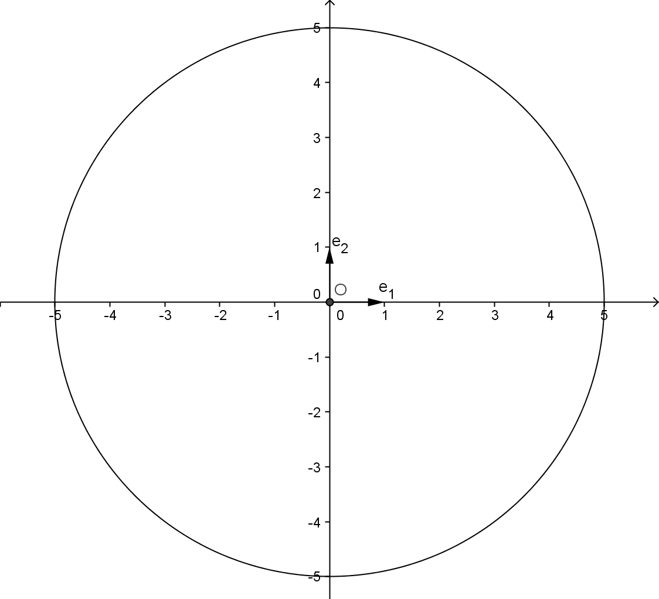
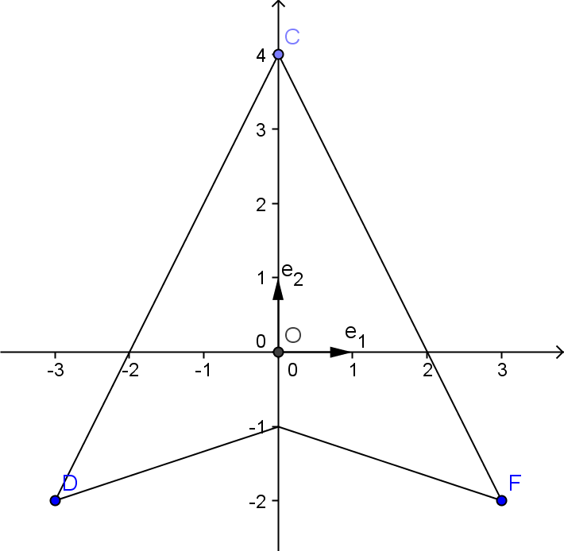
Frame
Every object has a frame

Slide 8
Vector relative to frame
x = x₁⋅e₁ + x₂⋅e₂
e₁ and e₂ are called unit or basis vectors

Slide 9
Matrix and frame
Every vector can be expressed as:
x = x₁⋅e₁ + x₂⋅e₂
For Linear Transformations (and Matrix Transformations) we can show:
M⋅x = x₁⋅M⋅e₁ + x₂⋅M⋅e₂
Consequence:
Knowing the images of the unit vectors
(knowing the image of the frame)
means knowing the Transformation

Slide 10
Matrix and frame
The images of the unit vectors are the columns of the Matrix
Consequence:
Knowing the images of the unit vectors means knowing the Columns of the Matrix

Slide 11
2D Matrix Example
What does the following 2D matrix do?
Extract the basis vectors (the columns of M)
p = [2 1]
q = [-1,2]

Slide 12
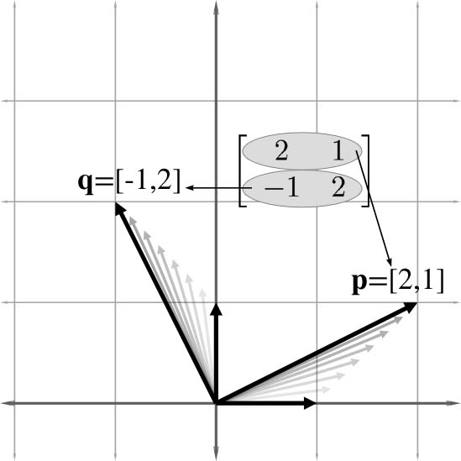

Slide 13
What’s the Transformation?
It moves the unit axes [1, 0] and [0, 1] to the new axes.
It does the same thing to all vectors.
Visualize a box being transformed from one coordinate system to the other.
This is called a skew box.

Slide 14
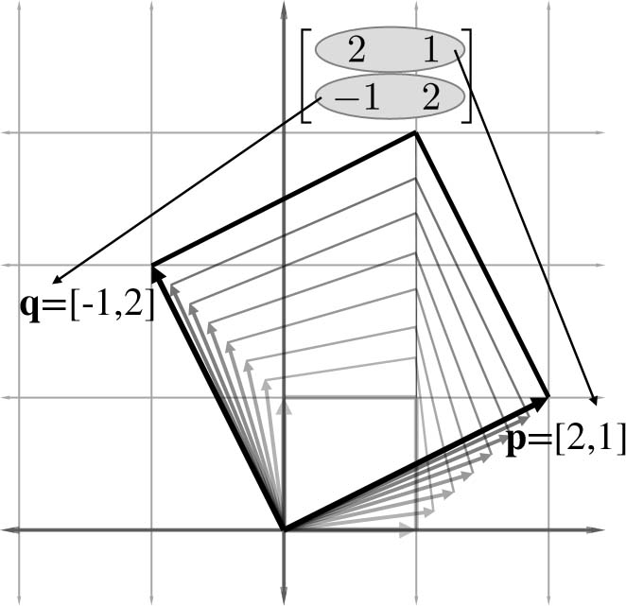

Slide 15
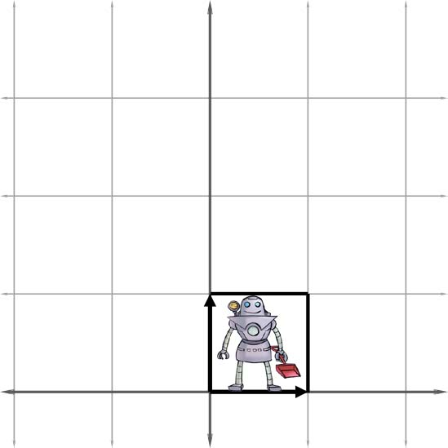
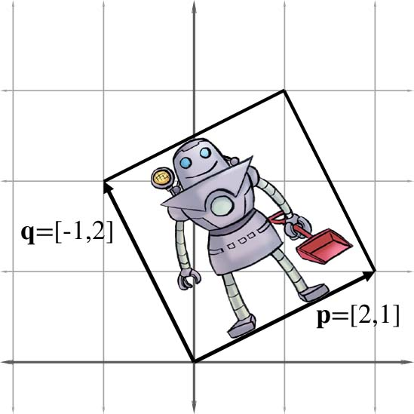
Before
After

Slide 16
So What Does It Do?
Rotates objects counterclockwise by a small amount.
Scales them up by a factor of two.

Slide 17
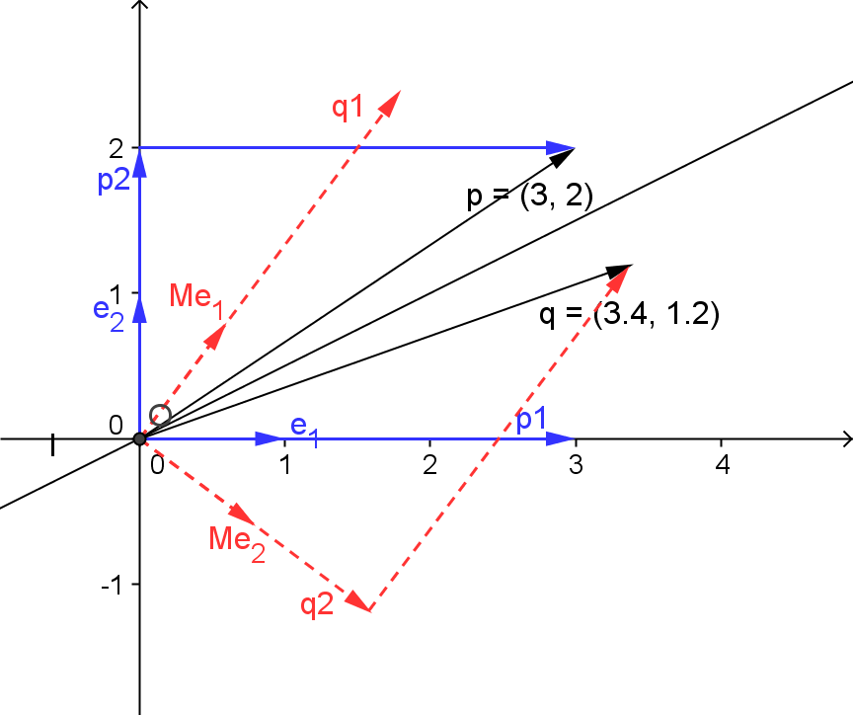
Example continued
p = 3⋅e₁ + 2⋅e₂
q = 3⋅M⋅e₁ + 2⋅M⋅e₂

Slide 18
Matrix
3D Matrix and transformation

Slide 19
Axial Displacements
Can rewrite any vector v = [x y z] as a sum of axial displacements.

Slide 20
Basis Vectors
Define three unit vectors along the axes:
Then we can rewrite the axial displacement equation as
v = xe₁ +ye₂ +ze₃
e₁, e₂, e₃ are known as basis vectors

Slide 21
Orthonormal Basis Vectors
Best to use an orthonormal basis
Orthonormal means unit vectors that are pairwise orthogonal:
p•q = q•r = r•p = 0
Otherwise things can get weird.

Slide 22

Matrix From Basis Vectors
Construct a matrix M using p, q, r as the columns of the matrix:

Slide 23
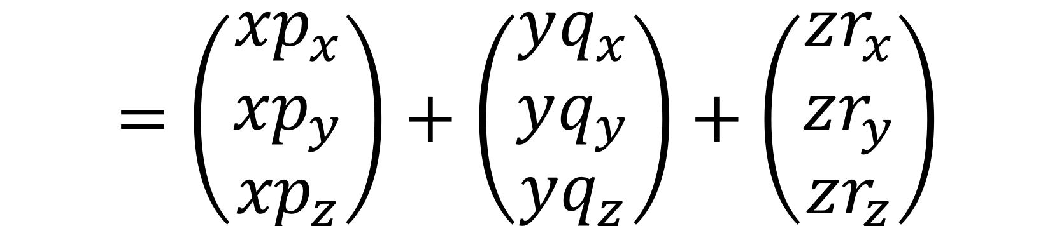
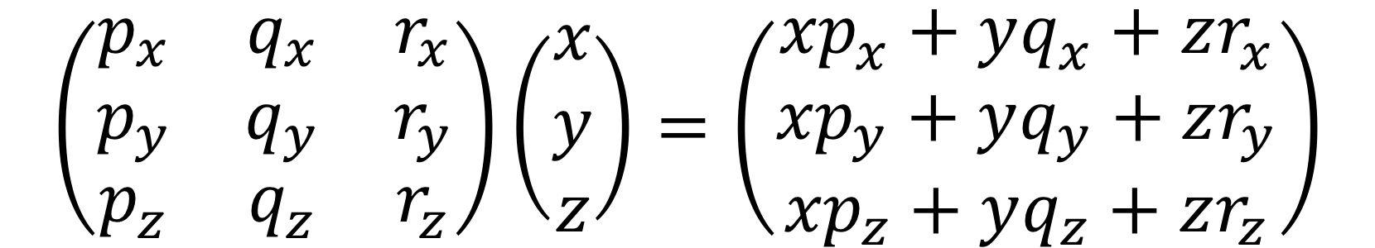
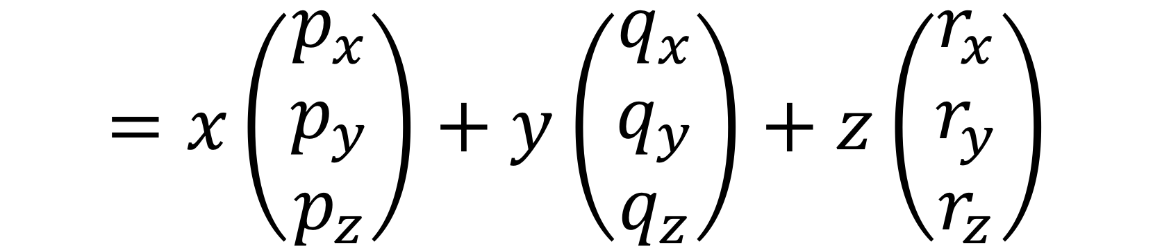
What Does This Matrix Do?

Slide 24
Transformation by a Matrix
If we interpret the columns of a matrix as the basis vectors of a coordinate space, then multiplication by the matrix performs a coordinate space transformation.
If Ma = b, we say that vector a is transformed by the matrix M into vector b.

Slide 25
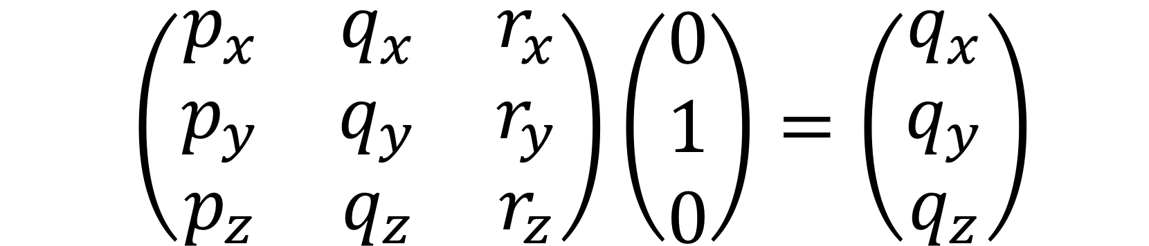
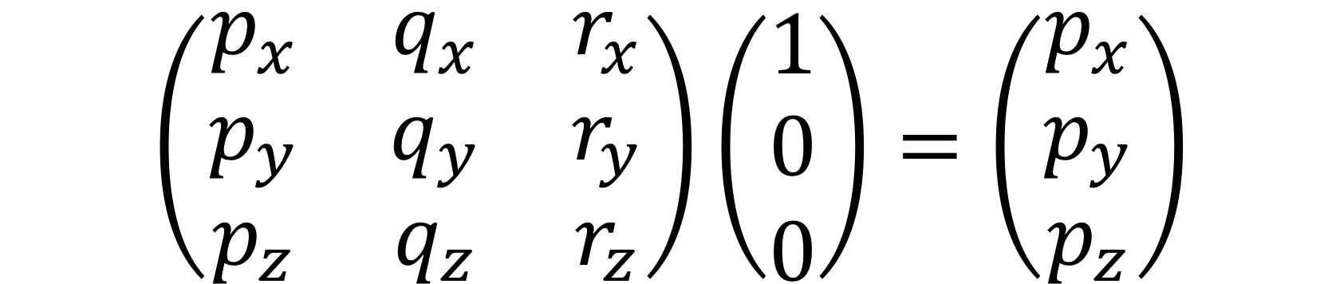
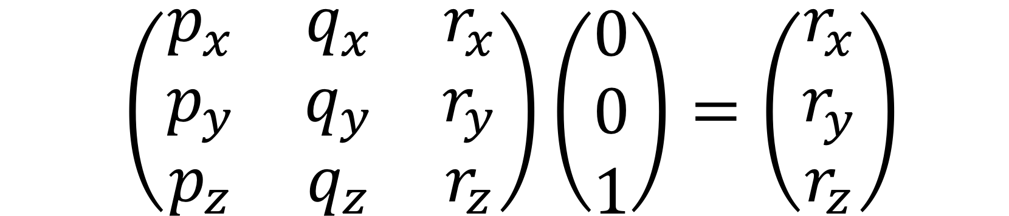
Conversely
See what M does to the basis vectors e₁, e₂, e₃.

Slide 26
Visualize The Matrix
Each column of a matrix is a basis vector after transformation.
Given an arbitrary matrix, visualize the transformation by its effect on the standard basis vectors – the columns of the matrix.
Given an arbitrary linear transformation, create the matrix by visualizing what it does to the standard basis vectors and using that for the columns of the matrix.

Slide 27
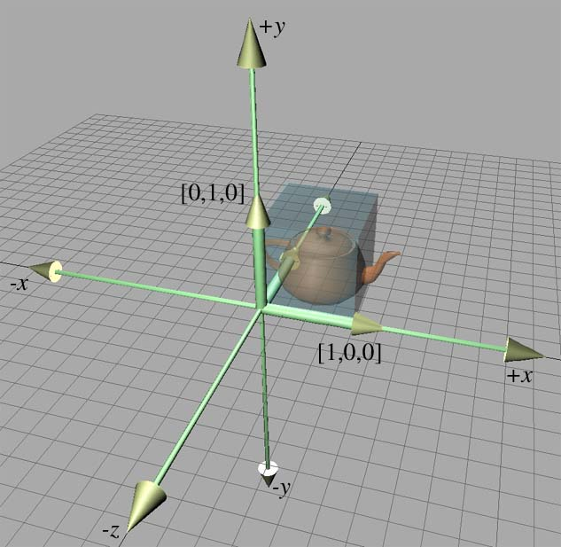
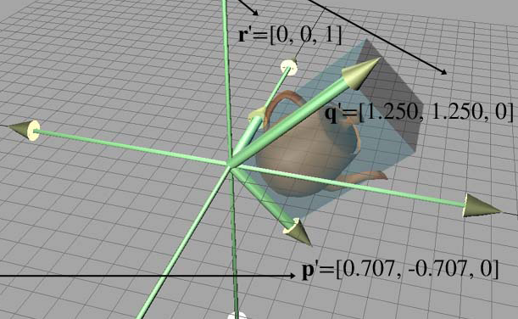
3D Transformation Example
After
Before

Slide 28
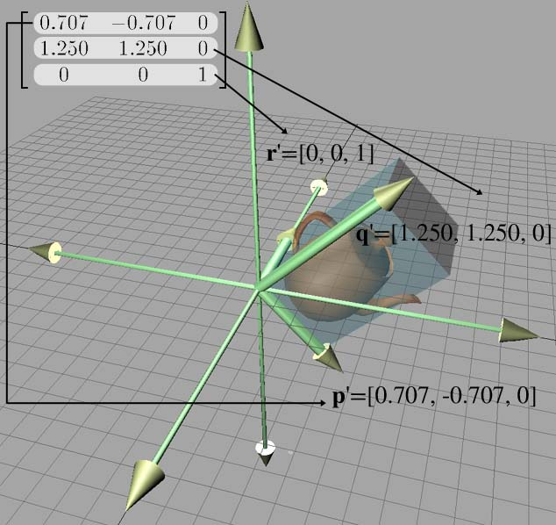

Slide 29
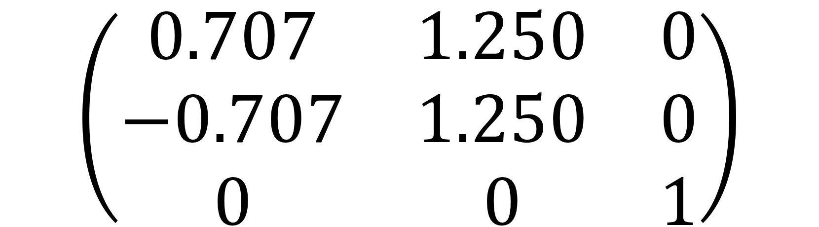
What’s the Matrix?
Get columns of matrix from new basis vectors.
So what does it do?
Rotates objects clockwise by 45°.
Scales them up along the y axis.

Slide 30
Matrices & Linear Transforms
Scale

Slide 31
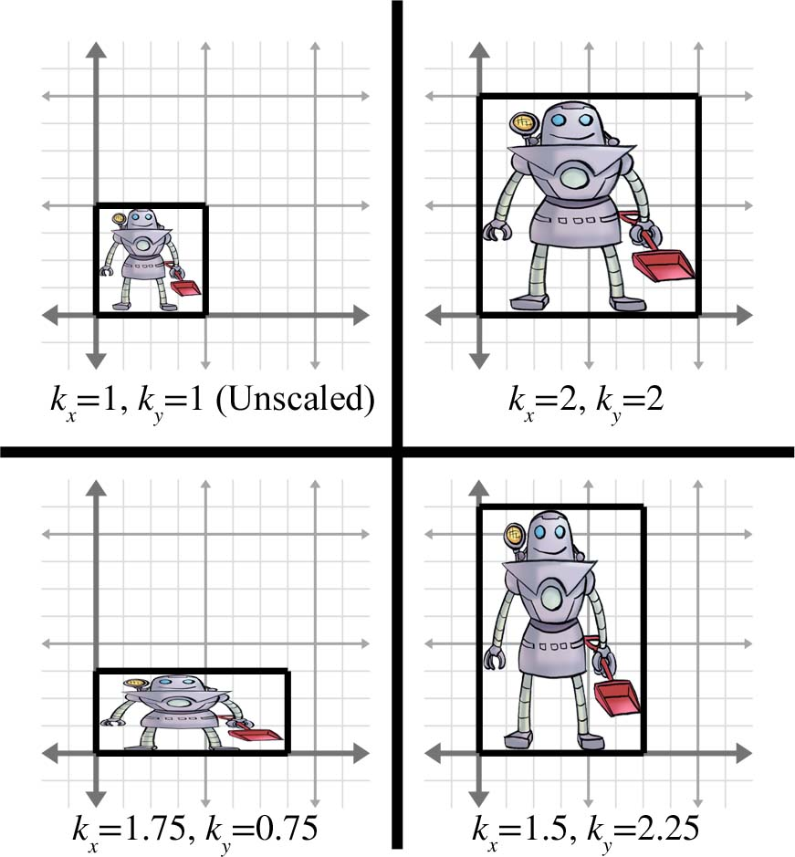
Scaling Along Cardinal Axes in 2D

Slide 32
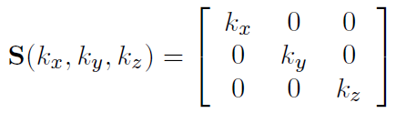
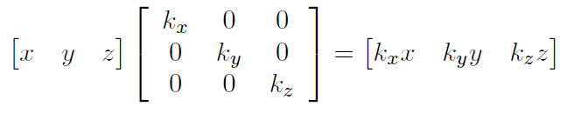
3D Scale Matrix

Slide 33
Scale in Arbitrary Direction
The math for scaling in an arbitrary direction is intricate, but not too tricky.
For game programmers it is not used very often.

Slide 34
Matrices & Linear Transforms
Orthographic Projection

Slide 35
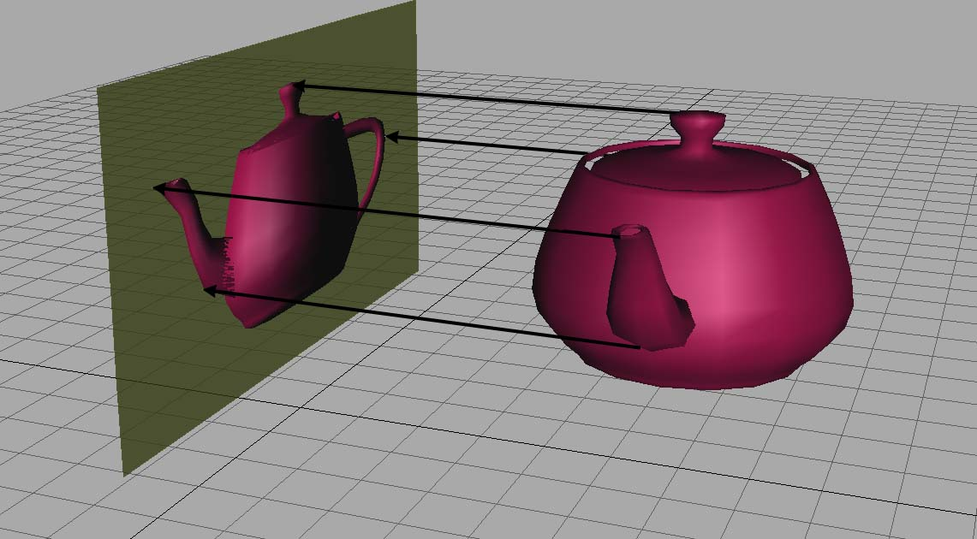
Orthographic Projection

Slide 36
Projecting Onto a Cardinal Axis
Projection onto a cardinal axis or plane most frequently occurs not by actual transformation, but by simply discarding one of the dimensions while assigning the data into a variable of lesser dimension.
For example, we may turn a 3D object into a 2D object by discarding the z components of the points and copying only x and y.
However, we can also project onto a cardinal axis or plane by using a scale value of zero on the perpendicular axis.
For completeness, we present the matrices for these transformations:

Slide 37
Projection onto axes
Matrix of projection onto the x₁-axis
Matrix of projection onto the x₂axis

Slide 38
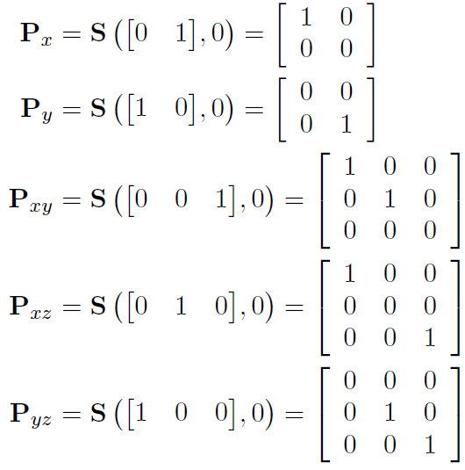

Slide 39
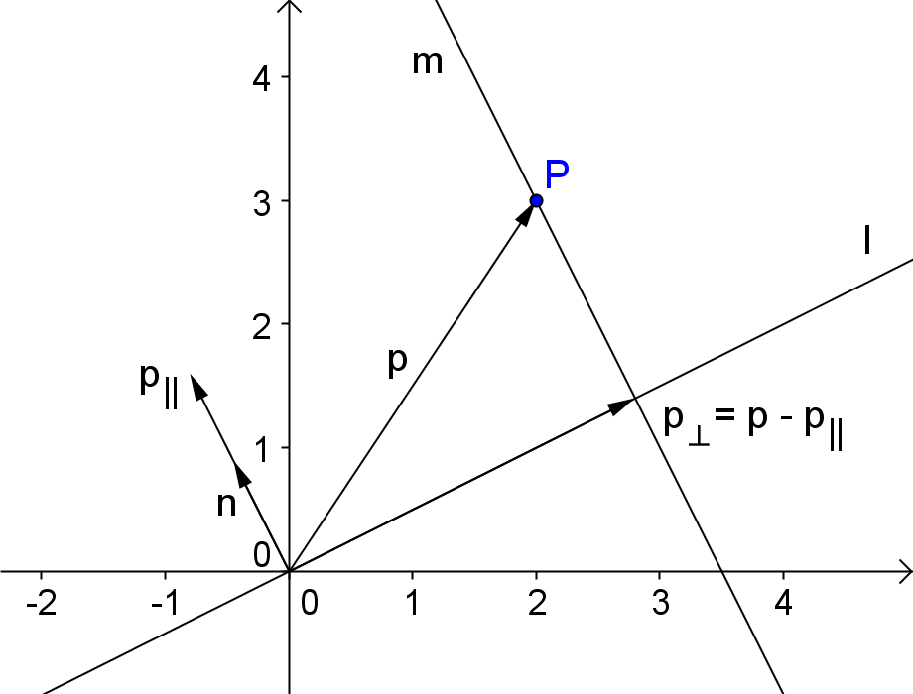
Projection onto line through origin
find components of p
parallel and perpendicular
to normal n

Slide 40
Projection onto line through origin
For any vector this formula will give its projection onto the line:
Use this formula to calculate the images of the unit vectors

Slide 41
Example
Line l: x₁ + 3x₂ = 0
Calculate the image of the unit vector e₁ for the projection onto line l

Slide 42
Exercise
Line l: x₁ + 3x₂ = 0
Calculate the image of the unit vector e₂ for the projection onto line l
Give the matrix of the projection onto line l

Slide 43
Projection using normalized normalvector
Use this formula to calculate the images of the unit vectors
P(e₁) = e₁ - (e₁ · n) n
P(e₂) = e₂ - (e₂ · n) n

Slide 44
General formula for projection (1)
P(e₁) = e₁ - (e₁ · n) n
n normalized
Image of e₁

Slide 45
General formula for projection (2)
P(e₂) = e₂ - (e₂ · n) n
n normalized
Image of e₂

Slide 46
General formula for Matrix of projection
Image of e₁
n normalized
Image of e₂
n normalized
But
n normalized
n normalized

Slide 47
exercise
Line l: 2x₁ - x₂ = 0
n normalized
Give the matrix of the projection onto line l

